Slide 1
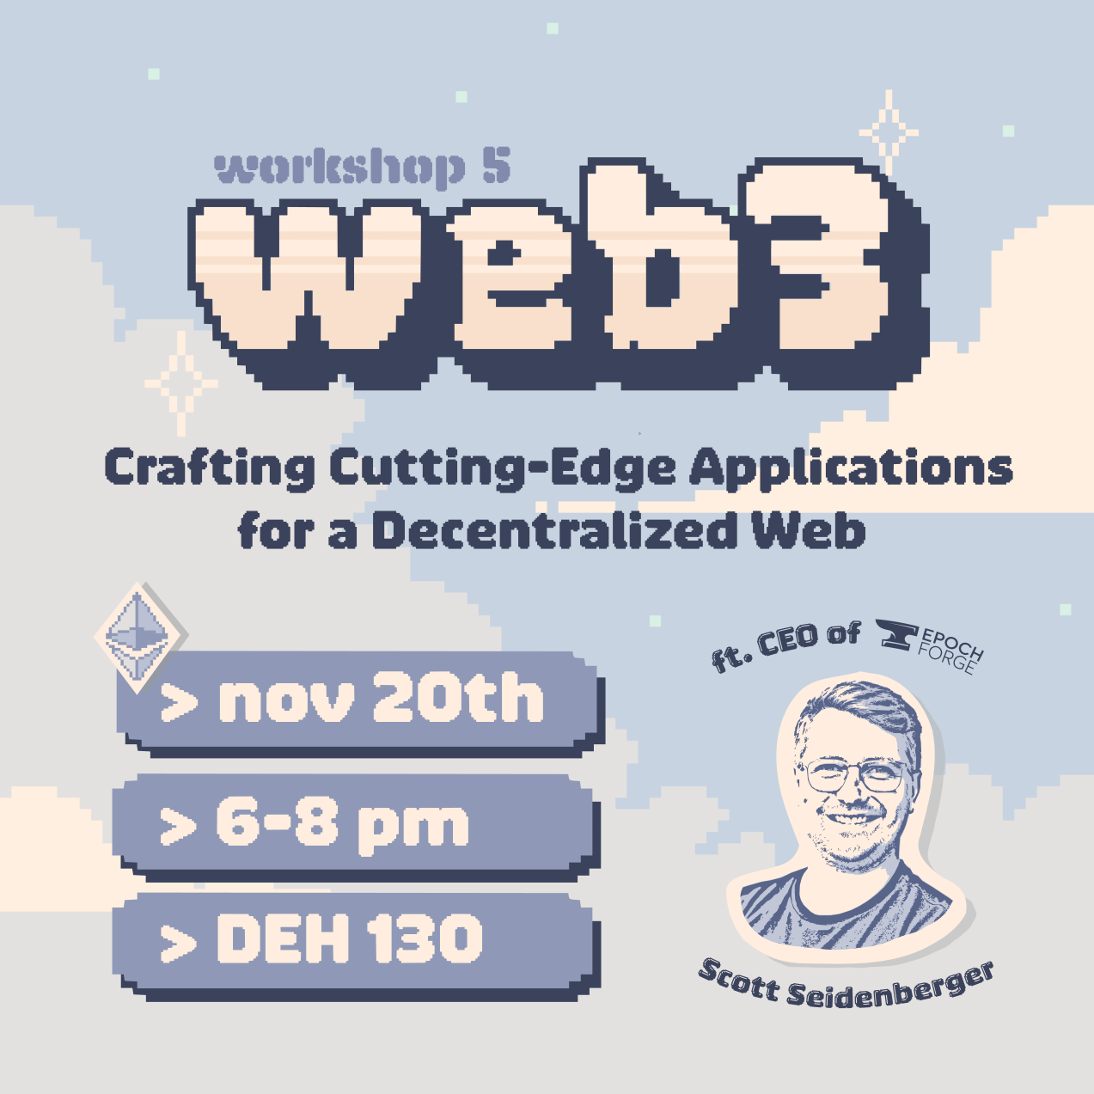
web3 Workshop: Crafting Cutting-Edge Applications for a Decentralized Web
Scott Seidenberger
OU Data Science & Analytics Institute
SecretLab
seidenberger@ou.edu

Slide 2
Overview
Introduction
Personal Intro
Evolution of the Internet
The web3 Stack
Blockchain in web3
Consensus
web3 Use Cases
Web dApp Demo
Important Note:
This is a whole new technology stack with a lot going on, and the goal of this workshop is to get you briefly acquainted with concepts to guide your further exploration.

Slide 3
Introduction

Slide 4
What is web3?
web3 is the third generation of the internet
It is the broadest term to talk about both a family of technologies and emergent properties that are economic and political
Interconnects users and data in a decentralized protocols
Open, Permissionless, Trustless, Accessible

Slide 5
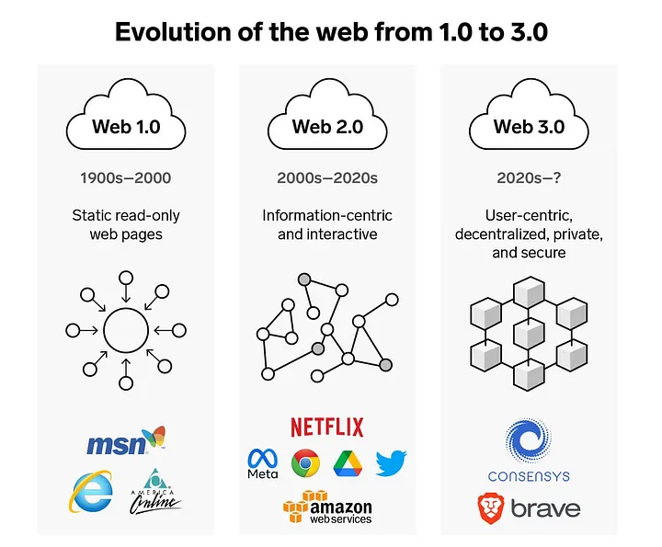
The Evolution of the Internet
https://medium.com/@POPaPOTEMUS/the-evolution-of-the-web-b428c07c9ddd
https://community.nasscom.in/communities/digital-transformation/web-30-next-avatar-internet

Slide 6
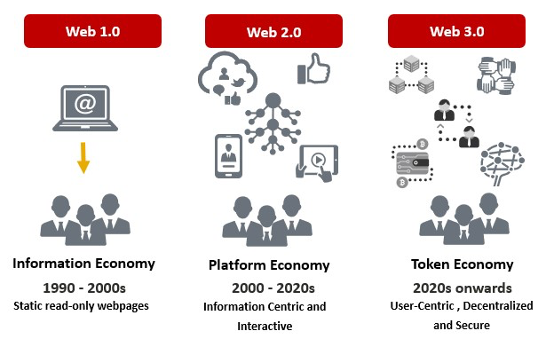
The Evolution of the Internet
https://medium.com/@POPaPOTEMUS/the-evolution-of-the-web-b428c07c9ddd
https://community.nasscom.in/communities/digital-transformation/web-30-next-avatar-internet

Slide 7
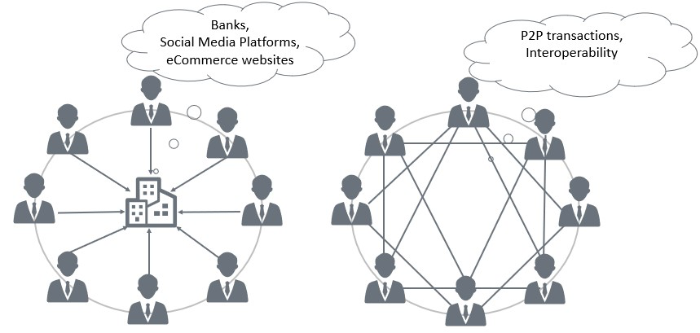
The Evolution of the Internet
https://medium.com/@POPaPOTEMUS/the-evolution-of-the-web-b428c07c9ddd
https://community.nasscom.in/communities/digital-transformation/web-30-next-avatar-internet

Slide 8
Learning the Jargon
One of the biggest challenges in learning new technology is learning the terminology
Blockchain != web3
Cryptocurrency != blockchain

Slide 9
Learning some Jargon
web3 == the suite of technologies, governance frameworks, and economic models that enable decentralized systems
Blockchain == a distributed ledger (database) that records transactions across multiple computers in a way that ensures security, transparency, and immutability. This decentralized structure prevents any single point of failure and makes it difficult for the data to be altered retroactively.
Cryptocurrency == an application of a public blockchain that uses cryptography and protocols to control the creation of additional units and verifies asset transfers. Creates digital scarcity.

Slide 10
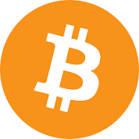
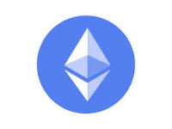
Blockchain Basics
At a very high level…
A blockchain is a database structure that links its current state to its previous states
A collection of records
Linked to each other
Strongly resistant to alteration
Leverages asymmetric cryptography
When we distribute this database, we get a public blockchain network
Like Bitcoin
Or Ethereum

Slide 11
Blocks
A block contains a set of transactions
A block always references the previous block via cryptographic hash
When you have all the blocks you can compute the current state
A transaction can be simple or complex
Complex transactions don’t just have a sender and receiver, but also call data to smart contracts
Smart contracts are simply programs stored on a blockchain that run when predetermined conditions are met.

Slide 12
Architecture
…..
…..
…..
…
…
…
…
…..
…
…
…
…
…
…
…
…
…
…
…
…
Alice: 5
Bob: 10
Clark: 2
Alice: 5
Bob: 10
Clark: 2
Consensus
Alice: 5
Bob: 10
Clark: 2
Consensus
Alice: 5
Bob: 10
Clark: 2
Consensus
Consensus
State
State
State
State
Ethereum Virtual Machine (EVM)
Ethereum Virtual Machine (EVM)
Ethereum Virtual Machine (EVM)
Ethereum Virtual Machine (EVM)
Node

Slide 13
Blocks
Alice SEND 3 to Clark
Clark SEND 1 to Bob
Alice: 5
Bob: 10
Clark: 2
Alice: 2
Bob: 11
Clark: 4
State
Proposed new state
…
…
…
…
Alice SEND 3 to Clark
Clark SEND 1 to Bob

Slide 14
Architecture
…..
…..
…..
…
…
…
…
Alice SEND 3 to Clark
Clark SEND 1 to Bob
…..
…
…
…
…
…
…
…
…
…
…
…
…
Alice: 2
Bob: 11
Clark: 4
Alice: 5
Bob: 10
Clark: 2
Consensus
Alice: 5
Bob: 10
Clark: 2
Consensus
Alice: 5
Bob: 10
Clark: 2
Consensus
Alice: 2
Bob: 11
Clark: 4
Consensus
State
State
State
State
Ethereum Virtual Machine (EVM)
Ethereum Virtual Machine (EVM)
Ethereum Virtual Machine (EVM)
Ethereum Virtual Machine (EVM)
Node

Slide 15
Consensus
Who gets to make the next block that everyone else processes and uses to update their state?
Consensus! A way to agree and coordinate behavior.
Proof-of-Work (Bitcoin)
Nodes compete to solve a hashing problem; winner gets to make the next block.
Proof-of-Stake (Ethereum)
Nodes get to propose blocks relative to how much of the crypto they put “at stake”, if they propose invalid blocks, they get slashed, or that stake is taken away from them.

Slide 16
Consensus
This process keeps repeating and building a large chain with a complex state
By creating sets of transactions that are interconnected with the state, you can compute anything on top of the Ethereum Virtual Machine (EVM) to build applications or advanced functionality.
Handling the chain growth, speed, security, etc. are all areas of active research and development!

Slide 17
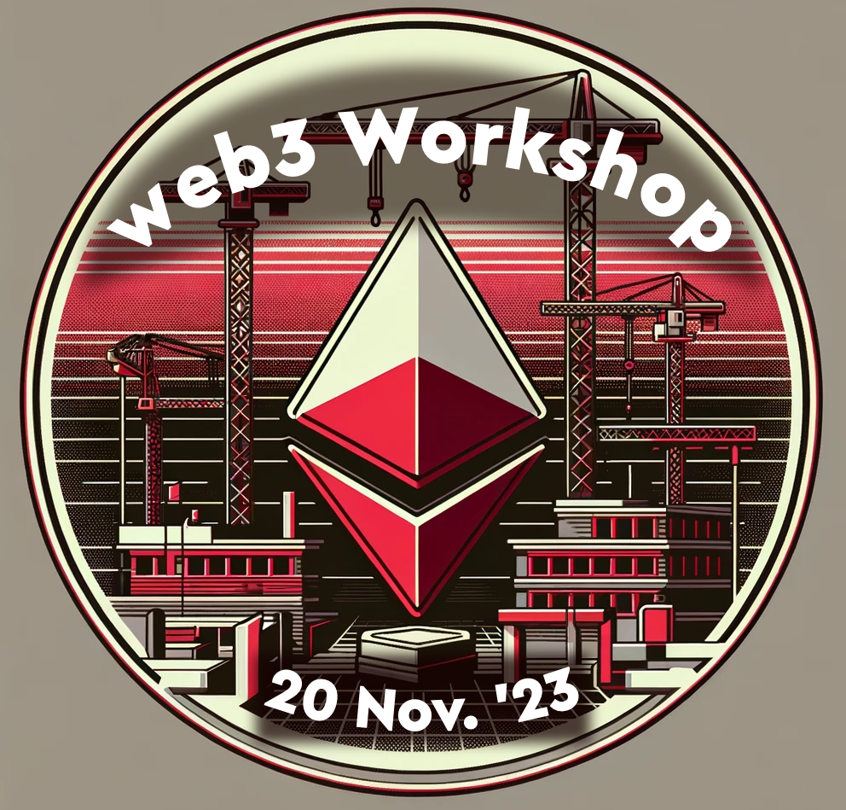
web3 Workshop: Crafting Cutting-Edge Applications for a Decentralized Web
Demo:
Building a simple, unstoppable, web dApp

Slide 18
Build Unstoppable Applications
The web3 industry is filled with companies that are building bridges from web2 to web3 to help devs like you leverage the benefits of web3 using the frameworks and techniques you already know
Libraries
Web3.js: This is a collection of libraries that allow you to interact with a local or remote Ethereum node using HTTP, IPC, or WebSocket. It's widely used for building decentralized applications (DApps) on the Ethereum blockchain.
Ethers.js: Similar to Web3.js, Ethers.js is a lightweight library that makes it easier to interact with the Ethereum blockchain. It's known for its simplicity and ease of use, especially in wallet integration and smart contract interaction.
SDKs
Truffle Suite: Truffle provides development environment, testing framework, and asset pipeline for blockchain using the Ethereum Virtual Machine (EVM). It's used for writing, testing, and deploying smart contracts.
Moralis Web3 SDK: This SDK offers a simplified way to build Web3 applications. It provides tools for user authentication, syncing and indexing blockchain data, and interacting with smart contracts.
APIs
Infura API: Infura offers a suite of tools for connecting applications to Ethereum and IPFS. It provides reliable, scalable infrastructure for running Ethereum nodes and accessing blockchain data.
Alchemy API: Similar to Infura, Alchemy provides powerful APIs for blockchain development, enabling developers to access data, compute, and storage on the blockchain. It's known for its high-performance and scalable infrastructure.

Slide 19
Build Unstoppable Applications
Applications that are heavily dependent or wholly reliant on decentralized systems are called dApps
They run on a P2P network of computers rather than a single computer, most are mediated by a shared database (ie. a blockchain)
Trustless Environment: Users can interact directly without needing a trusted intermediary. This is also referred to as permissionless development (build on the work of others!)
Resilience: dApps are resistant to censorship and cannot be shut down by a single entity.
Security: dApps have their own vulnerabilities just like web2!
Transparency: All transactions are public and verifiable, ensuring fairness and transparency. This doesn’t mean that the ~content~ of transactions are visible (they can be encrypted) but you can verify that the protocol is functioning according to the predefined set of rules.

Slide 20
Demo
Please ask questions and I’ll make sure that the Github is available if you want to look at it after the workshop.
This is just a short demo with limited time and a lot of new concepts.
The big takeaway is to consider where web3 could benefit your use cases in the future!
Building a web dApp
Get the price of Ethereum with Chainlink (decentralized API)
Serve an image from Storj (decentralized storage)
Deploy it to IPFS (decentralized static hosting)

Slide 21
Connecting to Data
For our web dApp, we want to get the Price of Ethereum. How do we do that?
Web2 = single trusted entity
Coinbase, Coinmarketcap, Yahoo! Finance
These endpoints could…
Change in so many ways
Have downtime
Be permissioned or censored
Hacked!
Web3 = decentralized API with decentralized data!

Slide 22
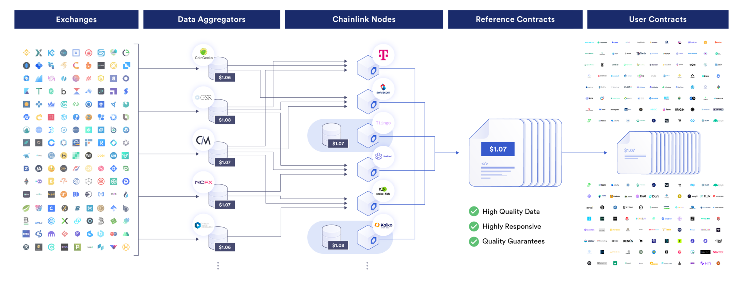
Chainlink Price Feed

Slide 23
Connecting to Storage
The second thing we wanted to do with the web dApp is serve an image
Web2 = single entity
Store and serve it yourself or use a cloud storage provider
Expensive, potentially slow, very manually configured for resilience and/or performance
Web3 = decentralized storage network
Store data on a decentralized network of nodes
Data is pulled from all over the world!
Resilience and performance comes standard

Slide 24
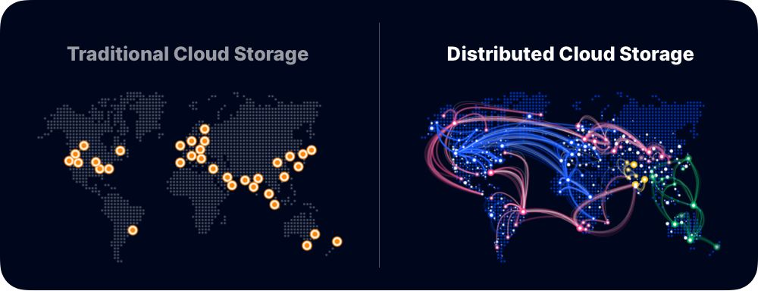
Storj

Slide 25
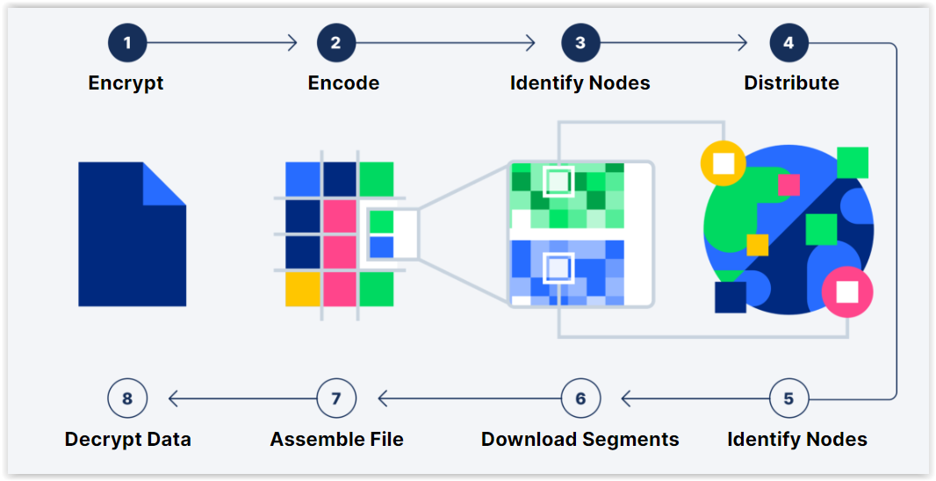
Storj

Slide 26
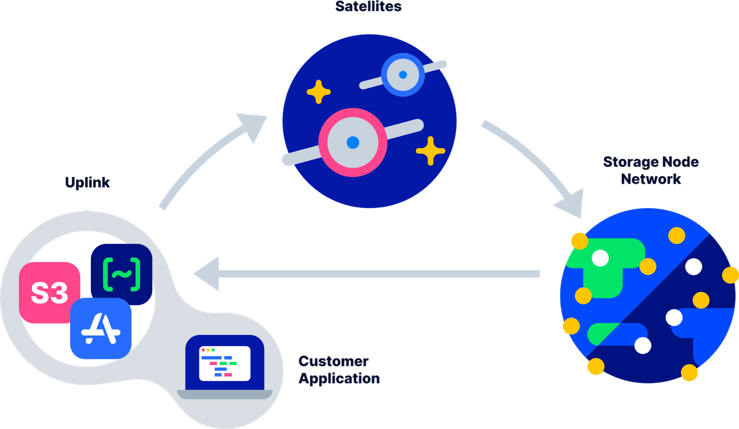
Storj

Slide 27
Decentralized Hosting
Finally, we want to host our site
Web2 = single entity
Store and serve it yourself or use a cloud storage provider
Expensive, potentially slow, very manually configured for resilience and/or performance
Web3 = decentralized storage network
Store data on a decentralized network of nodes
Data is pulled from all over the world!
Resilience and performance comes standard

Slide 28
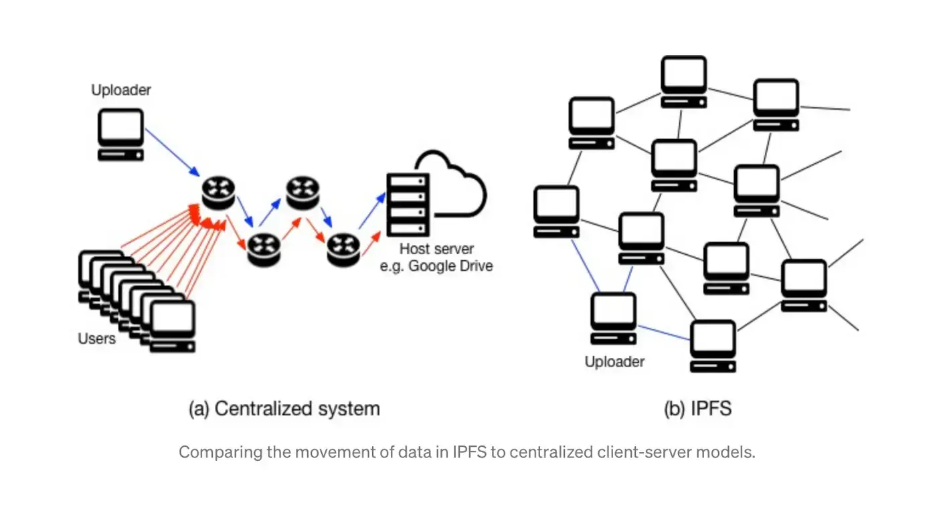
IPFS

Slide 29
Mint a POAP
Download Metamask
Create Wallet
Passphrase
Write down secret pneumonic
Download POAP app
Connect Wallet
Scan QR Code
Mint on Gnosis (free mint)

