Slide 1



web3 Workshop:
Crafting Cutting-Edge
Applications for a Decentralized Web
Scott Seidenberger
OU Data Science & Analytics Institute
SecretLab
seidenberger@ou.edu

Slide 2
Overview
Introduction
  Personal Intro
  Evolution of the Internet
The web3 Stack
Blockchain in web3
  Consensus
web3 Use Cases
Web dApp Demo
Important Note:
This is a whole new technology stack with a lot going on, and the goal of this workshop is to get you briefly acquainted with concepts to guide your further exploration.

Slide 3
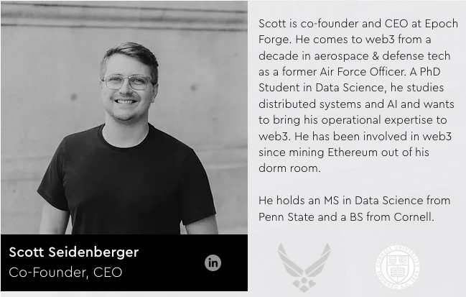

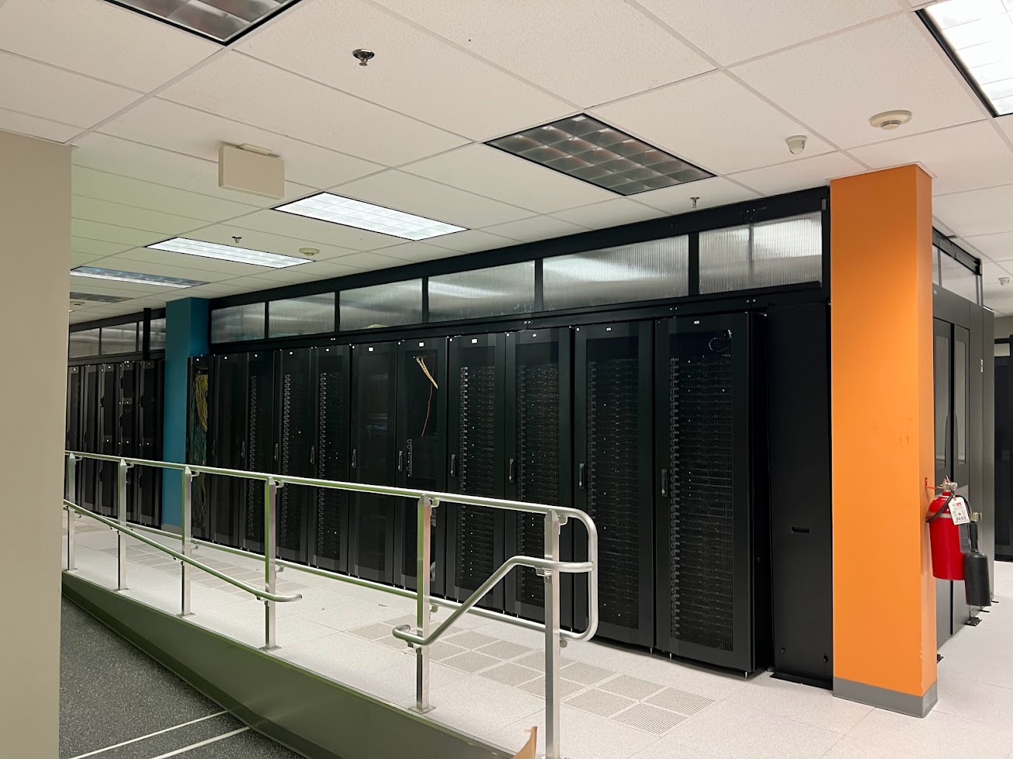
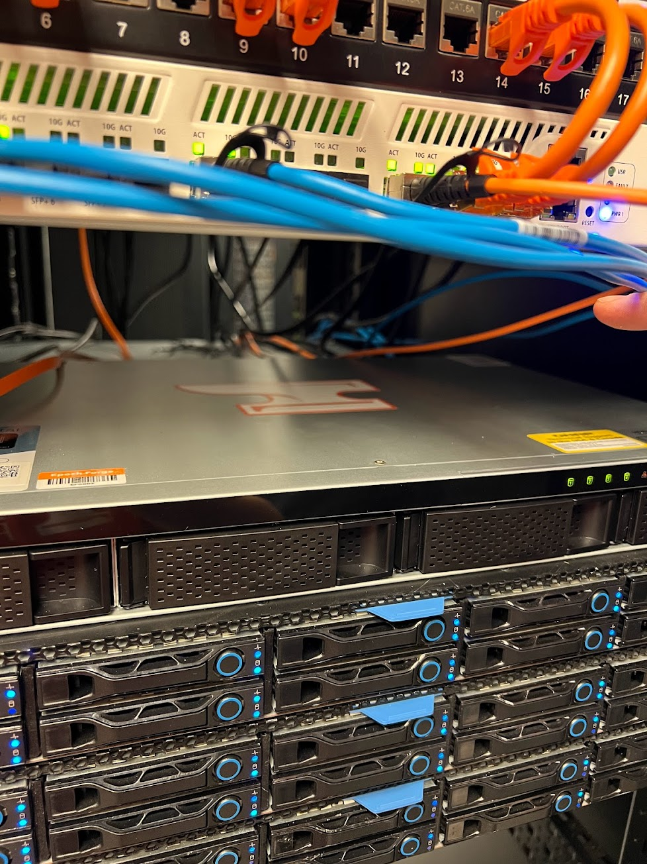

Introduction

Slide 4
What is web3?
  web3 is the third generation of the internet
  It is the broadest term to talk about both a family of technologies and emergent properties that are economic and political
  Interconnects users and data in a decentralized protocols
  Open, Permissionless, Trustless, Accessible

Slide 5

A map of internet cables from 1989 to 2021. Source: NYT

Slide 6
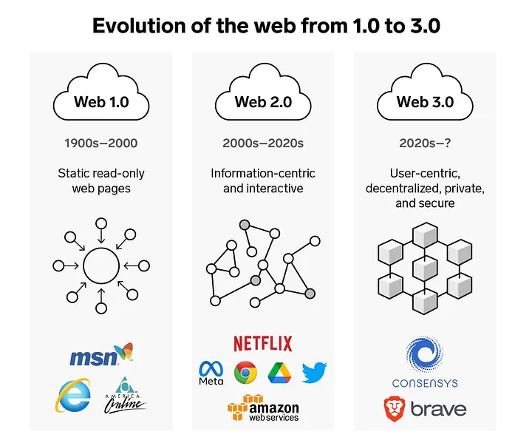
The Evolution of the Internet
https://medium.com/@POPaPOTEMUS/the-evolution-of-the-web-b428c07c9ddd
https://community.nasscom.in/communities/digital-transformation/web-30-next-avatar-internet

Slide 7
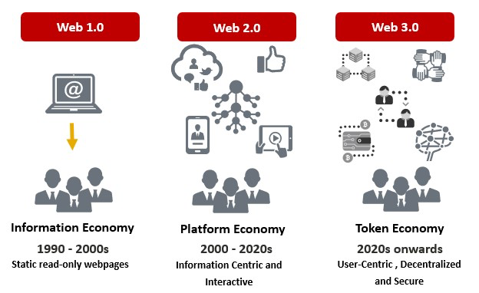
The Evolution of the Internet
https://medium.com/@POPaPOTEMUS/the-evolution-of-the-web-b428c07c9ddd
https://community.nasscom.in/communities/digital-transformation/web-30-next-avatar-internet

Slide 8
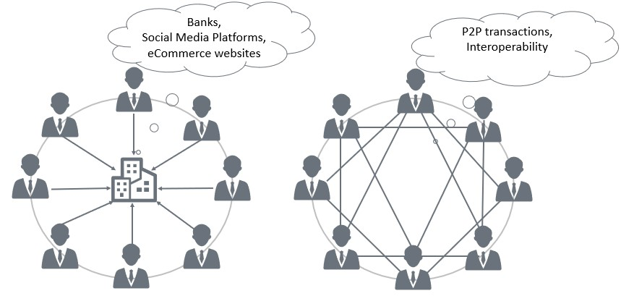
The Evolution of the Internet
https://medium.com/@POPaPOTEMUS/the-evolution-of-the-web-b428c07c9ddd
https://community.nasscom.in/communities/digital-transformation/web-30-next-avatar-internet

Slide 9
Protocol vs Corporate Networks
“Protocol networks”, like email and the web, are open systems controlled by communities of software developers and other network stakeholders. These networks are egalitarian, democratic, and permissionless: open to anyone and free to access. In these systems, money and power tend to flow to the network edges, incentivizing systems to grow around them.
“Corporate networks” are networks that companies, instead of communities, own and control. These are like walled gardens with one groundskeeper; they’re theme parks controlled by a single megacorp. Corporate networks run centralized, permissioned services that allow them to quickly develop advanced features, attract investment, and accrue profits to reinvest in growth. In these systems, money and power flow to the network center, to companies that own the networks, and away from users and developers at the network edges.
https://a16zcrypto.com/posts/article/read-write-own-intro/
Notes:
Why does this matter? Corporations interests are often not aligned with users and other stakeholders!

Slide 10
Learning the Jargon
One of the biggest challenges in learning new technology is learning the terminology
Blockchain != web3
Cryptocurrency != blockchain

Slide 11
Learning some Jargon
web3 == the suite of technologies, protocols, governance frameworks, and economic models that enable decentralized systems
Blockchain == a distributed ledger (database) that records transactions across multiple computers in a way that ensures security, transparency, and immutability. This decentralized structure prevents any single point of failure and makes it difficult for the data to be altered retroactively.
Cryptocurrency == an application of a public blockchain that uses cryptography and protocols to control the creation of additional units and verifies asset transfers. Creates digital scarcity.

Slide 12

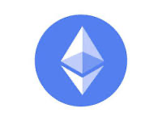
Blockchain Basics
At a very high level…
A blockchain is a database structure that links its current state to its previous states
  A collection of records
  Linked to each other
  Strongly resistant to alteration
  Leverages asymmetric cryptography
When we distribute this database, we get a public blockchain network
  Like Bitcoin
  Or Ethereum

Slide 13
Blocks
A block contains a set of transactions
A block always references the previous block via cryptographic hash
When you have all the blocks you can compute the current state
A transaction can be simple or complex
Complex transactions don’t just have a sender and receiver, but also call data to smart contracts
Smart contracts are simply programs stored on a blockchain that run when predetermined conditions are met.

Slide 14
Architecture
…..
…..
…..
…
…
…
…
…..
…
…
…
…
…
…
…
…
…
…
…
…
Alice: 5
Bob: 10
Clark: 2
Alice: 5
Bob: 10
Clark: 2
Consensus
Alice: 5
Bob: 10
Clark: 2
Consensus
Alice: 5
Bob: 10
Clark: 2
Consensus
Consensus
State
State
State
State
Ethereum Virtual Machine (EVM)
Ethereum Virtual Machine (EVM)
Ethereum Virtual Machine (EVM)
Ethereum Virtual Machine (EVM)
Node

Slide 15

Blocks
Alice SEND 3 to Clark
Clark SEND 1 to Bob
Alice: 5
Bob: 10
Clark: 2
Alice: 2
Bob: 11
Clark: 4
State
Proposed new state
…
…
…
…
Alice SEND 3 to Clark
Clark SEND 1 to Bob

Slide 16
Architecture
…..
…..
…..
…
…
…
…
Alice SEND 3 to Clark
Clark SEND 1 to Bob
…..
…
…
…
…
…
…
…
…
…
…
…
…
Alice: 2
Bob: 11
Clark: 4
Alice: 5
Bob: 10
Clark: 2
Consensus
Alice: 5
Bob: 10
Clark: 2
Consensus
Alice: 5
Bob: 10
Clark: 2
Consensus
Alice: 2
Bob: 11
Clark: 4
Consensus
State
State
State
State
Ethereum Virtual Machine (EVM)
Ethereum Virtual Machine (EVM)
Ethereum Virtual Machine (EVM)
Ethereum Virtual Machine (EVM)
Node

Slide 17
Consensus
Who gets to make the next block that everyone else processes and uses to update their state?
Consensus! A way to agree and coordinate behavior.
Proof-of-Work (Bitcoin)
  Nodes compete to solve a hashing problem; winner gets to make the next block.
Proof-of-Stake (Ethereum)
  Nodes get to propose blocks relative to how much of the crypto they put “at stake”, if they propose invalid blocks, they get slashed, or that stake is taken away from them.

Slide 18
Consensus
This process keeps repeating and building a large chain with a complex state
By creating sets of transactions that are interconnected with the state, you can compute anything on top of the Ethereum Virtual Machine (EVM) to build applications or advanced functionality.
Handling the chain growth, speed, security, etc. are all areas of active research and development!

Slide 19
Recap: Why does all matter?
So, we’ve created distributed, virtual state machines, what problems do they solve in the real world?
The key is in how the networks are controlled.
Software governs hardware, an inversion of the traditional hardware-software relationship.
Therefore, we can build guarantees into our applications.
We can have permissionless, composable, innovation where our interactions are not dependent on centralized entities whose incentives may not always be aligned with our own.

Slide 20
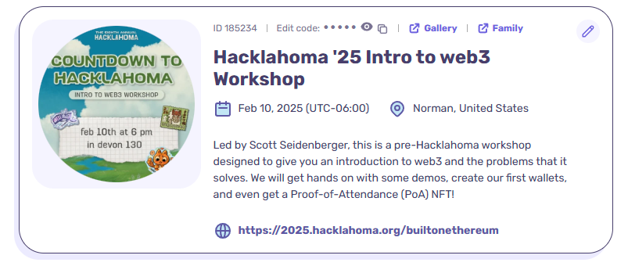
web3 Workshop:
Crafting Cutting-Edge
Applications for a Decentralized Web
Demo:
Building a simple, unstoppable, web dApp

Slide 21
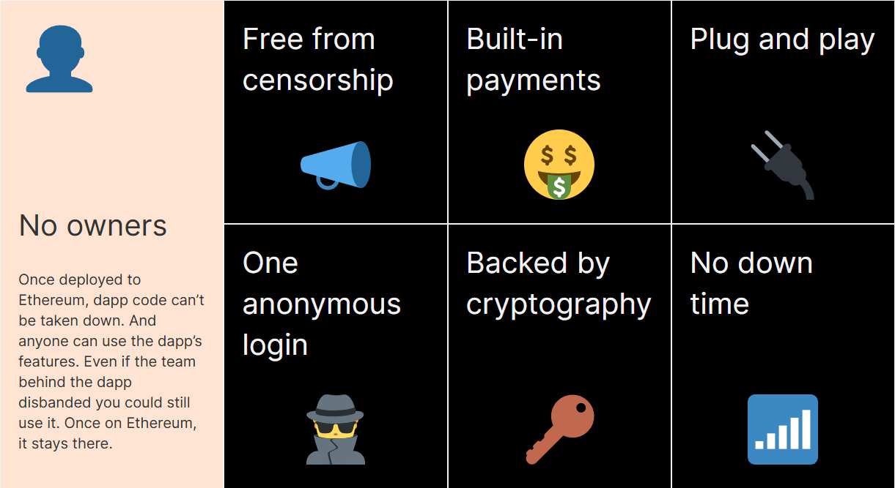
The Magic of dApps
https://ethereum.org/en/dapps/#what-are-dapps

Slide 22
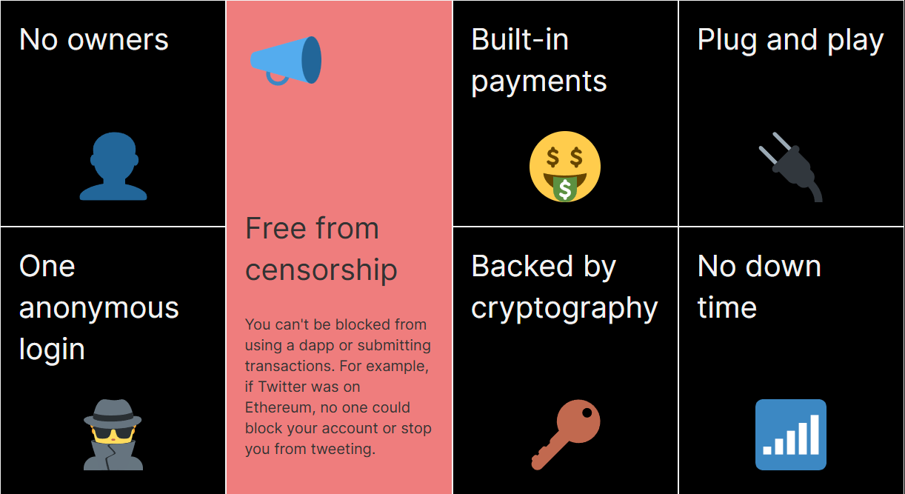
The Magic of dApps
https://ethereum.org/en/dapps/#what-are-dapps

Slide 23
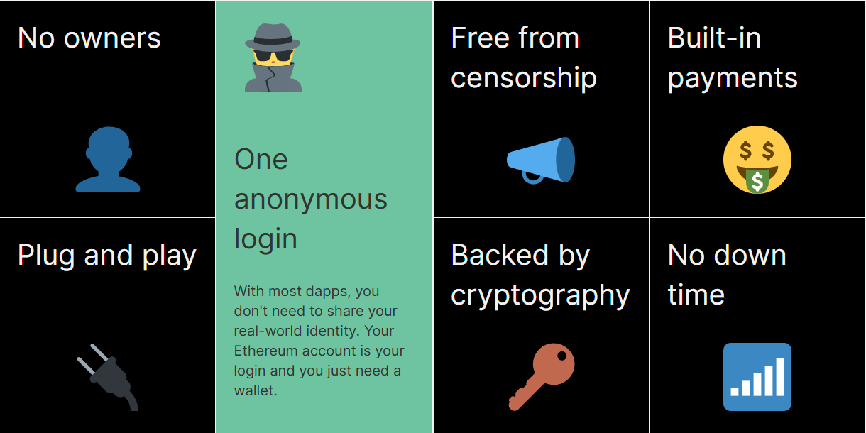
The Magic of dApps
https://ethereum.org/en/dapps/#what-are-dapps

Slide 24
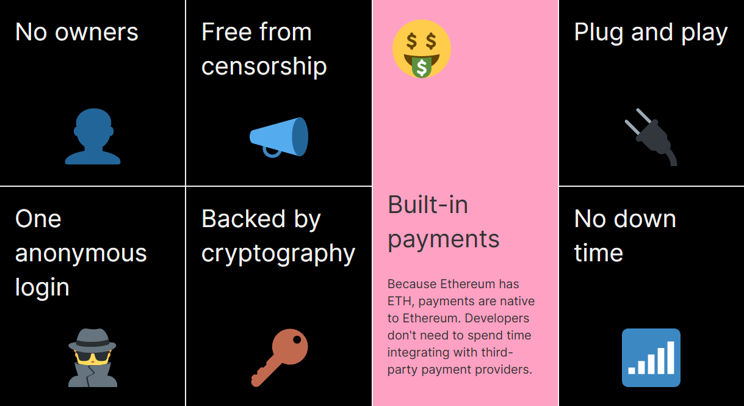
The Magic of dApps
https://ethereum.org/en/dapps/#what-are-dapps

Slide 25
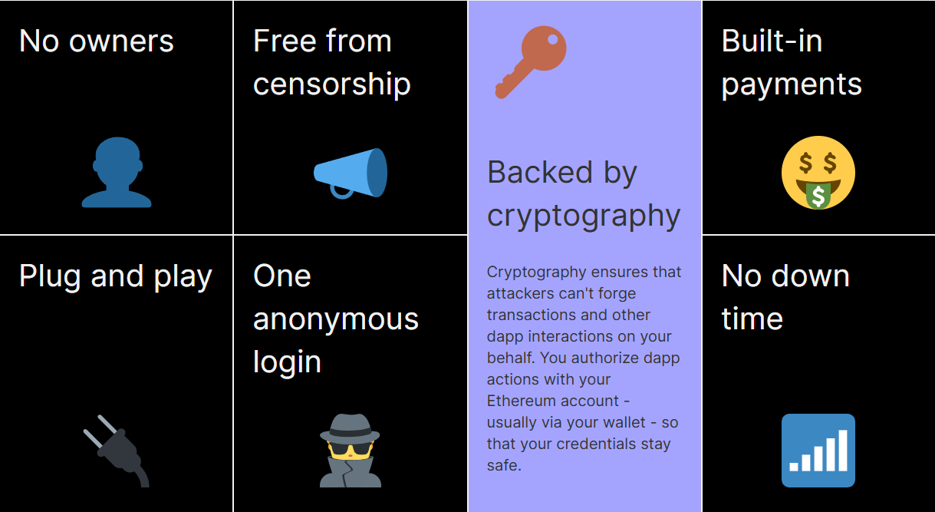
The Magic of dApps
https://ethereum.org/en/dapps/#what-are-dapps

Slide 26
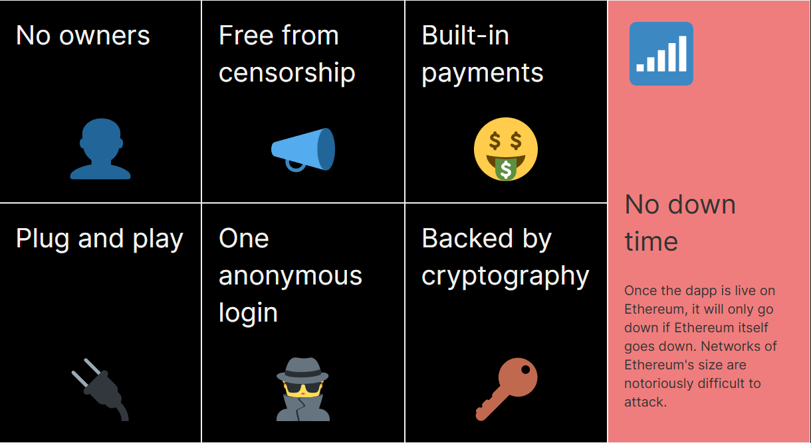
The Magic of dApps
https://ethereum.org/en/dapps/#what-are-dapps

Slide 27
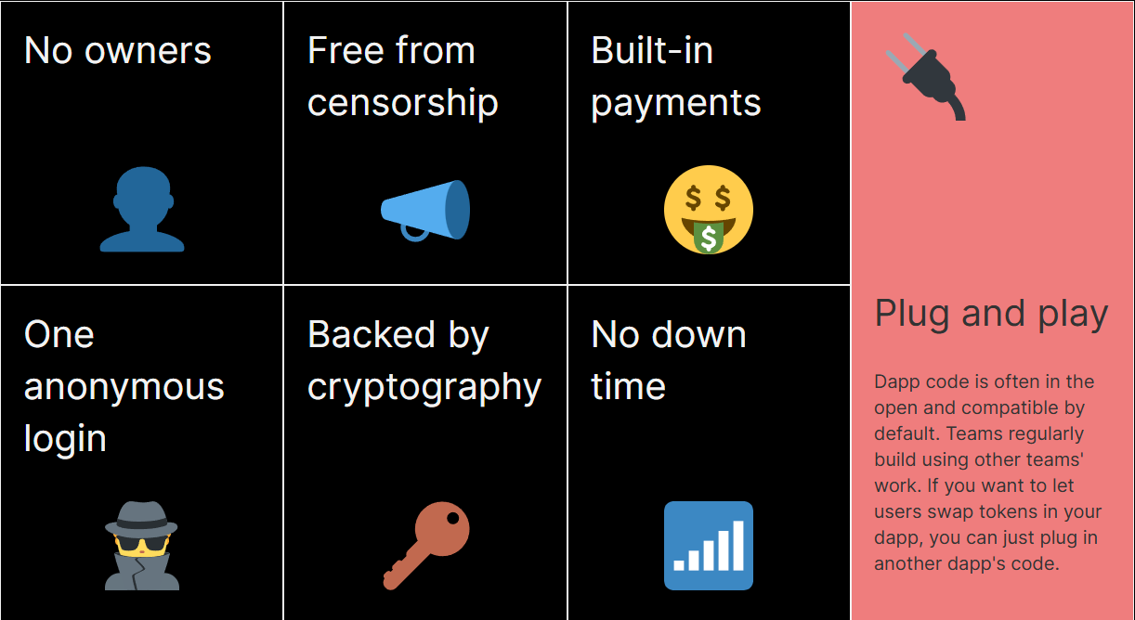
The Magic of dApps
https://ethereum.org/en/dapps/#what-are-dapps

Slide 28
How dApps Work
Dapps have their backend code (smart contracts) running on a decentralized network and not a centralized server.
They use the Ethereum blockchain for data storage and smart contracts for their app logic.
A smart contract is a set of instructions, like a computer program.
Once dApps are deployed on the Ethereum network you can't change them.
https://ethereum.org/en/dapps/#what-are-dapps

Slide 29
Build Unstoppable Applications
The web3 industry is filled with companies that are building bridges from web2 to web3 to help devs like you leverage the benefits of web3 using the frameworks and techniques you already know
Libraries
  Web3.js: This is a collection of libraries that allow you to interact with a local or remote Ethereum node using HTTP, IPC, or WebSocket. It's widely used for building decentralized applications (DApps) on the Ethereum blockchain.
  Ethers.js: Similar to Web3.js, Ethers.js is a lightweight library that makes it easier to interact with the Ethereum blockchain. It's known for its simplicity and ease of use, especially in wallet integration and smart contract interaction.
SDKs
  Truffle Suite: Truffle provides development environment, testing framework, and asset pipeline for blockchain using the Ethereum Virtual Machine (EVM). It's used for writing, testing, and deploying smart contracts.
  Moralis Web3 SDK: This SDK offers a simplified way to build Web3 applications. It provides tools for user authentication, syncing and indexing blockchain data, and interacting with smart contracts.
APIs
  Infura API: Infura offers a suite of tools for connecting applications to Ethereum and IPFS. It provides reliable, scalable infrastructure for running Ethereum nodes and accessing blockchain data.
  Alchemy API: Similar to Infura, Alchemy provides powerful APIs for blockchain development, enabling developers to access data, compute, and storage on the blockchain. It's known for its high-performance and scalable infrastructure.

Slide 30
Build Unstoppable Applications
Applications that are heavily dependent or wholly reliant on decentralized systems are called dApps
They run on a P2P network of computers rather than a single computer, most are mediated by a shared database (ie. a blockchain)
Trustless Environment: Users can interact directly without needing a trusted intermediary. This is also referred to as permissionless development (build on the work of others!)
Resilience: dApps are resistant to censorship and cannot be shut down by a single entity.
Security: dApps have their own vulnerabilities just like web2!
Transparency: All transactions are public and verifiable, ensuring fairness and transparency. This doesn’t mean that the ~content~ of transactions are visible (they can be encrypted) but you can verify that the protocol is functioning according to the predefined set of rules.

Slide 31
Demo
Please ask questions and the Github is available if you want to look at it after the workshop.
This is just a short demo with limited time and a lot of new concepts.
The big takeaway is to consider where web3 could benefit your use cases in the future!
Building a web dApp
  Get the price of Ethereum with Chainlink (decentralized API)
  Serve an image from Storj (decentralized storage)
  Deploy it to IPFS (decentralized static hosting)

Slide 32
Connecting to Data
For our web dApp, we want to get the Price of Ethereum. How do we do that?
Web2 = single trusted entity
  Coinbase, Coinmarketcap, Yahoo! Finance
  These endpoints could…
    Change in so many ways
    Have downtime
    Be permissioned or censored
    Hacked!
Web3 = decentralized API with decentralized data!

Slide 33
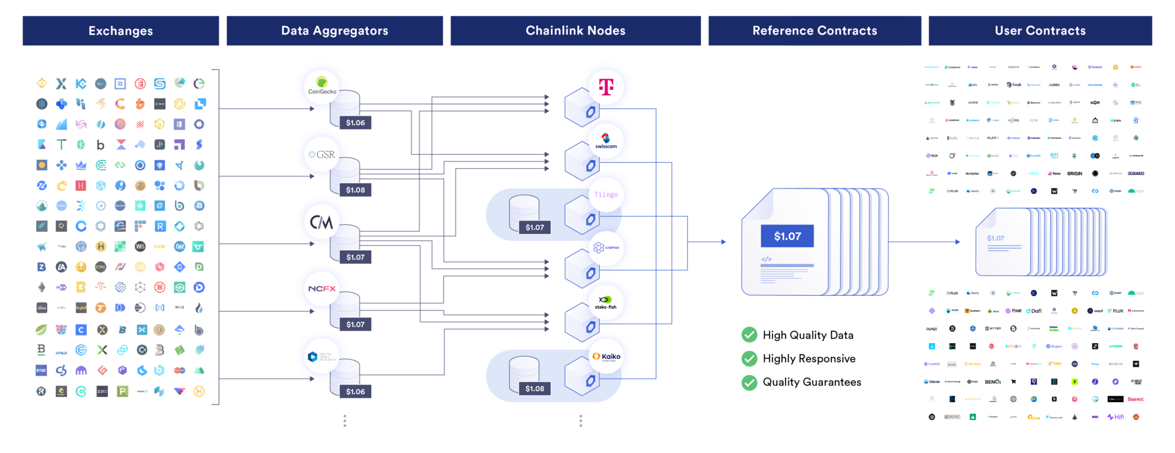
Chainlink Price Feed

Slide 34
Connecting to Storage
The second thing we wanted to do with the web dApp is serve an image
Web2 = single entity
  Store and serve it yourself or use a cloud storage provider
  Expensive, potentially slow, very manually configured for resilience and/or performance
Web3 = decentralized storage network
  Store data on a decentralized network of nodes
  Data is pulled from all over the world!
  Resilience and performance comes standard

Slide 35
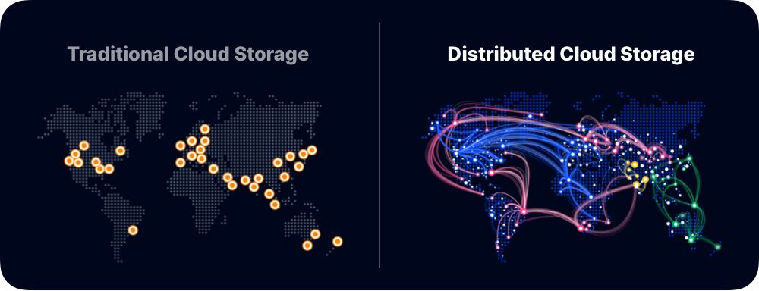
Storj

Slide 36
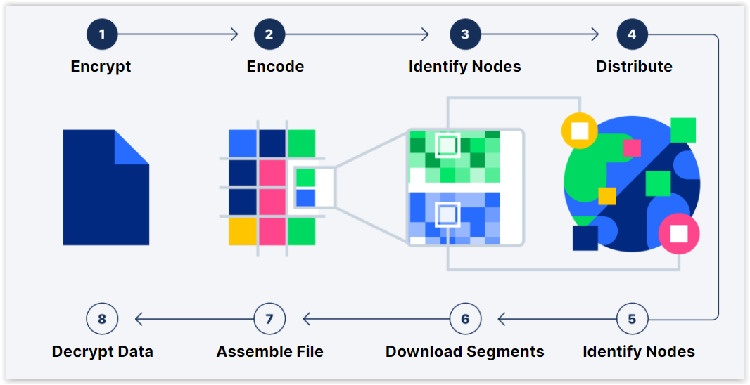
Storj

Slide 37
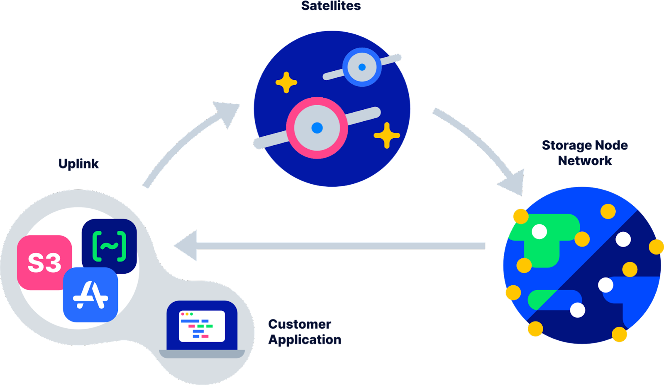
Storj

Slide 38
Decentralized Hosting
Finally, we want to host our site
Web2 = single entity
  Store and serve it yourself or use a cloud storage provider
  Expensive, potentially slow, very manually configured for resilience and/or performance
Web3 = decentralized storage network
  Store data on a decentralized network of nodes
  Data is pulled from all over the world!
  Resilience and performance comes standard

Slide 39
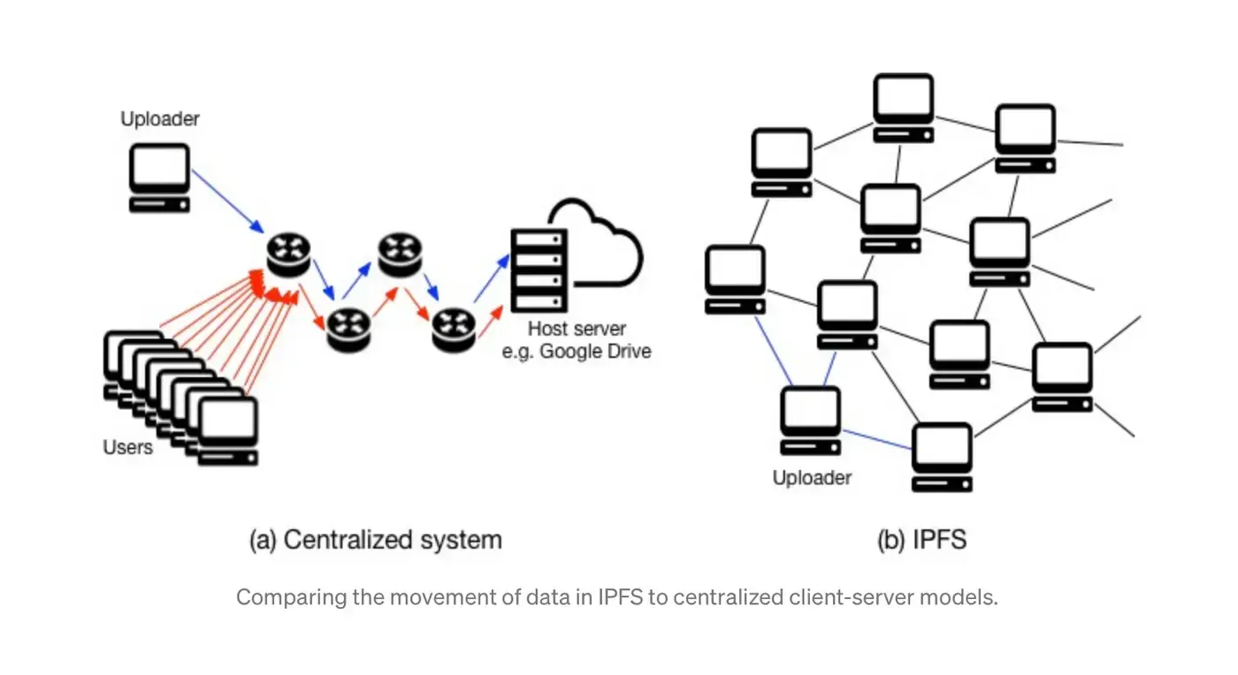
IPFS

Slide 40

Mint a POAP
Download Metamask
Create Wallet
  Passphrase
  Write down secret pneumonic
Download POAP app
Connect Wallet
Scan QR Code
Mint on Gnosis (free mint)

